Slide 1
DLD PROJECT LINE FOLLOWING ROBOT
TEAM MEMBERS :
EISHA 17K-3730
FATIMA 17K-3639
TALHA 17K-3721
HAFIZ HASSAN 17K-3841

Slide 2
we are going TO DISCUSS:
Introduction .
Components .
Our Robot .
Working Principle .
Applications .
Advantages .
Disadvantages .

Slide 3
WHAT IS A LINE FOLLOWING ROBOT?
IT’S A MACHINE THAT CAN FOLLOW A PATH.THE LINE CAN BE VISIBLE LIKE A BLACK LINE OR A WHITE SURFACE(or VICE VERSA) OR IT CAN BE A MAGNETIC LINE .

Slide 4
COMPONENTS :
ARDUINO BOARD .
DC MOTOR .
MOTOR DRIVER .
5 SENSOR ARRAY .
BATTERY .
WHEELS .

Slide 5
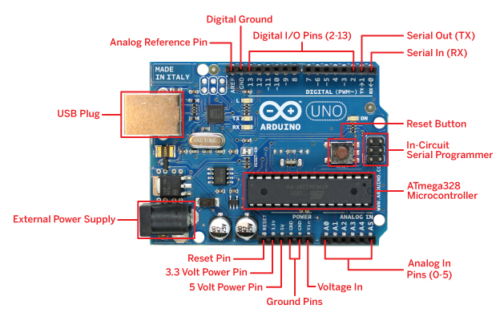
ARDUINO MICROPROCESSOR
The brain of robot in which program is loaded to do required functioning and is interfaced with sensors and motor driver to make the system work according to the requirement .

Slide 6
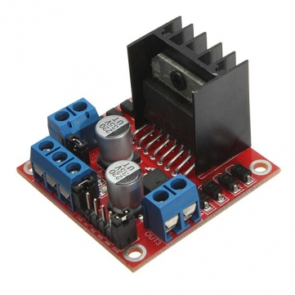
Motor driver (L298N)
The function of motor drivers is to take a low-current control signal and then turn it into a higher-current signal that can drive a motor .(5V-35V)

Slide 7
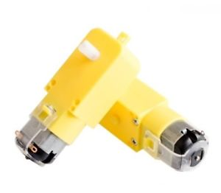
DC MOTORS
It’s controlled with DC voltage ,which are controlled through stepper motor driver, and can move in forward and backward direction .

Slide 8
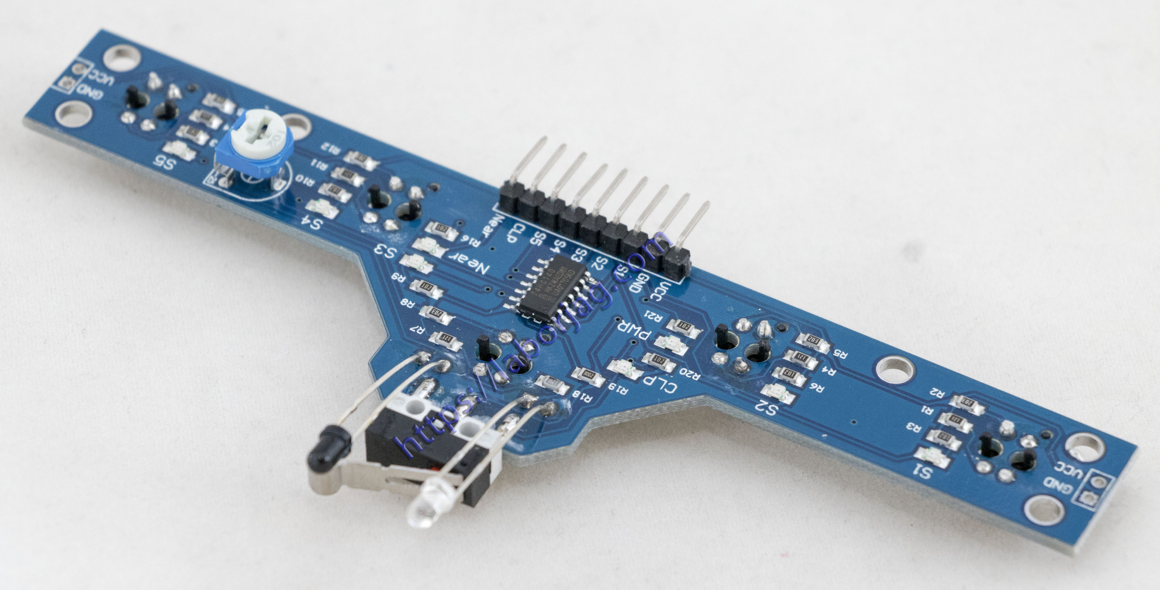
5 IR sensor array
Detect light emitted by transmitter, if receiver receives light, the wheel of that side will keep on moving and vice versa.

Slide 9
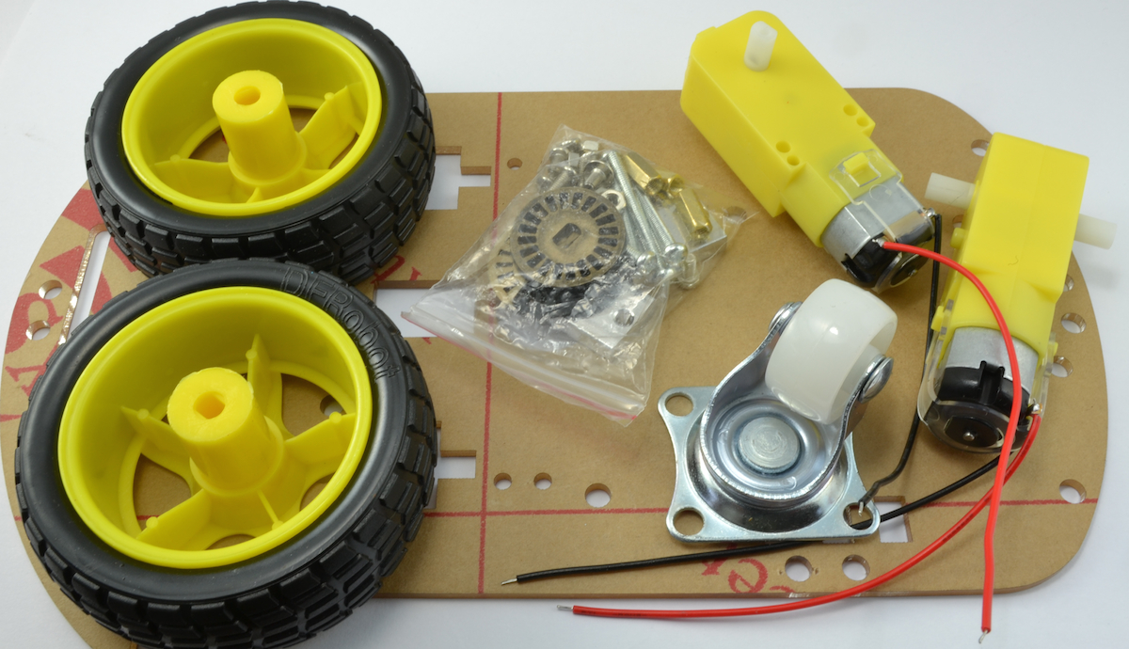
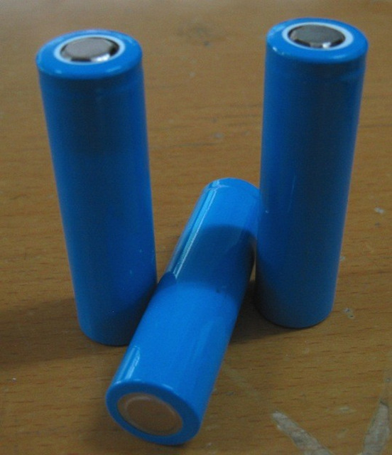
BATTERY, wheels and accessories

Slide 10
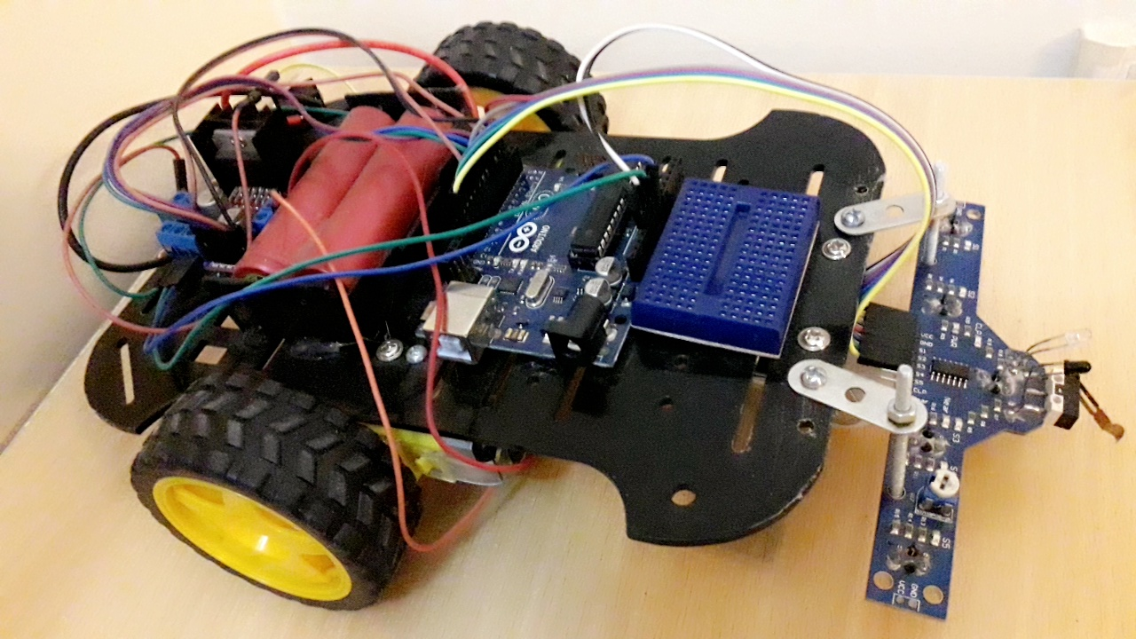
OUR robot

Slide 11

OUR robot

Slide 12
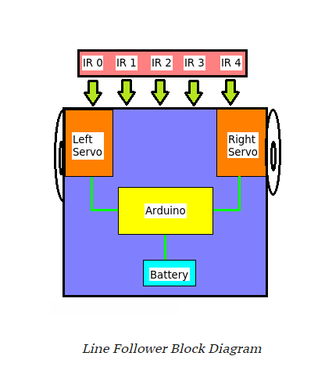
Block diagram

Slide 13
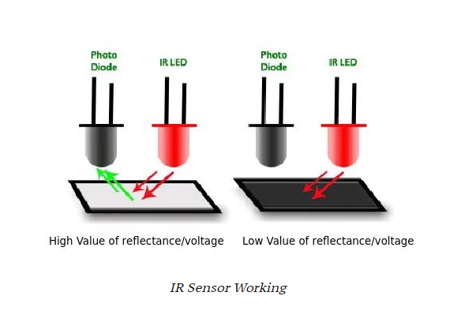
Principle of working

Slide 14
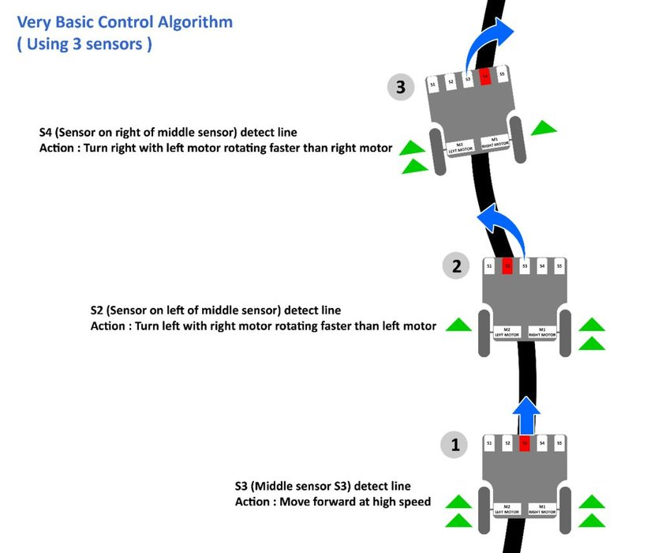

Slide 15
Application
Industrial automated equipment carriers.
Automated cars.
Tours guides in museums and other similar applications.
Deliver the mail within the office building.
Deliver medication in a hospital.

Slide 16
Advantages
Fit and forget.
Insensitive to environment factors like noise and lightening.
Capable of following a line which is specified to be followed.
Capable of taking various degrees of turns.
Cost effective.
Long distance application.

Slide 17
disadvantages
It requires power supply .
Lack of speed control makes it unstable .
Choice of line is made in the hardware abstraction and cannot be changed by software.
It moves on a fixed track .

Slide 18

ANY QUESTION?

